Slide 1
Math analysis
Day 19

Slide 2
Objective
Finish Presentations
Discuss second set of Vitruvia
Introduce Params with Level 3

Slide 3
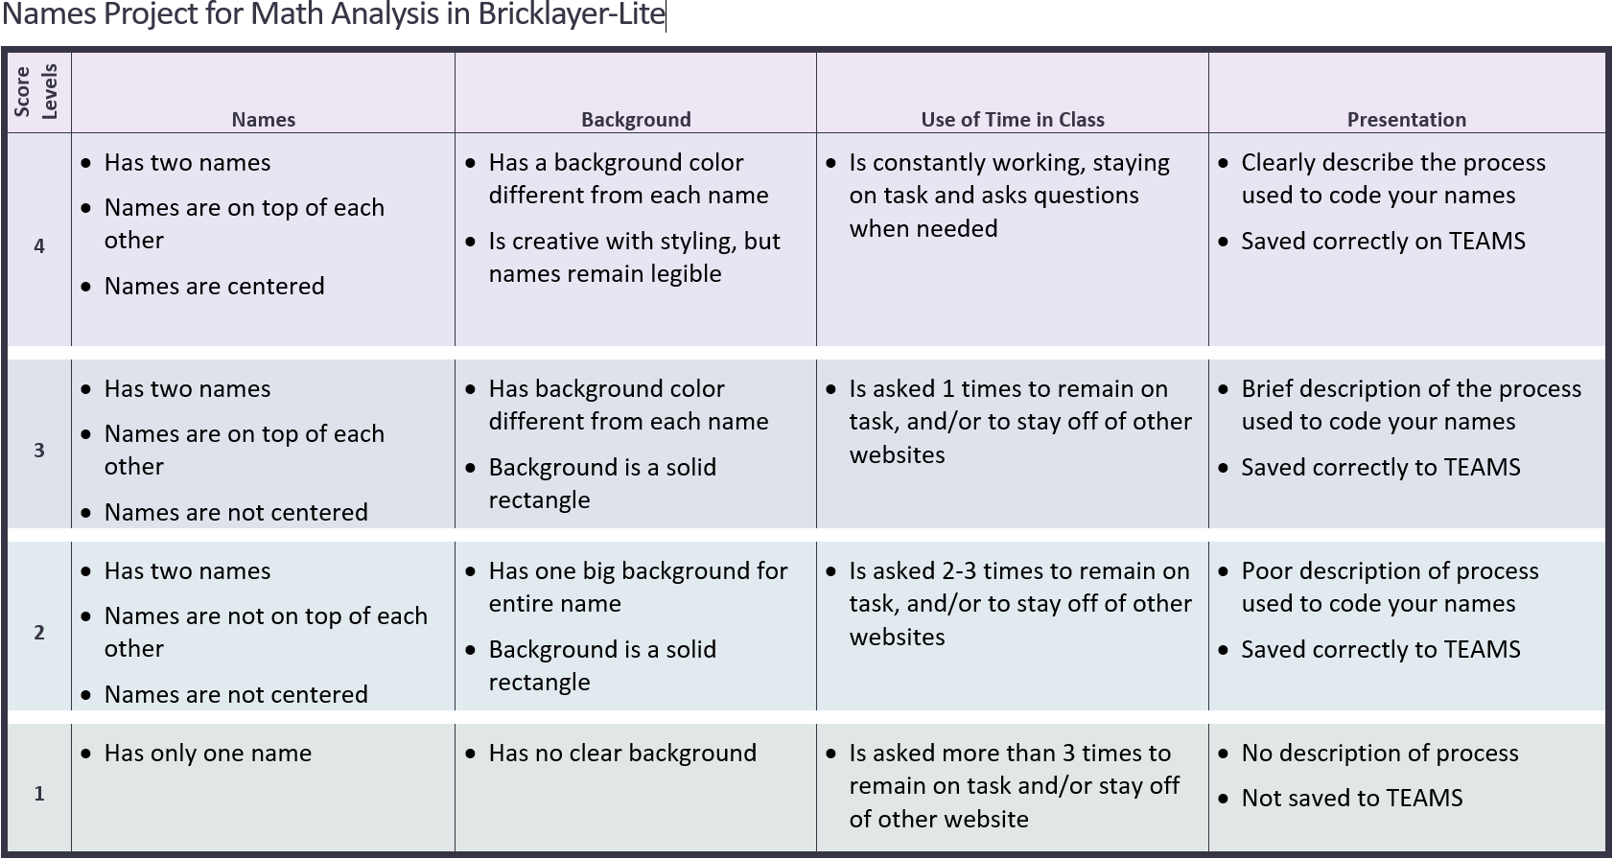

Slide 4
Presentations
Be able to easily maneuver within your code to answer questions about what each piece does
Describe your thought process, and how you came to your creation

Slide 5
Review Saving in Bricklayer Lite to Teams
Change “Filename” make sure it ends with .xml
Click Download XML
Open up Teams
Open the appropriate folder: ______________________
Click “upload” and select your recently downloaded file
Save
*Move the file to your Own Drive from your Downloads folder

Slide 6
Vitruvia to better prepare for Level 2 and Level 3
Vitruvia Concept 10
Vitruvia Concept 11
Vitruvia Concept 12
Vitruvia Concept 13
Vitruvia Concept 14
Vitruvia Concept 15

Slide 7
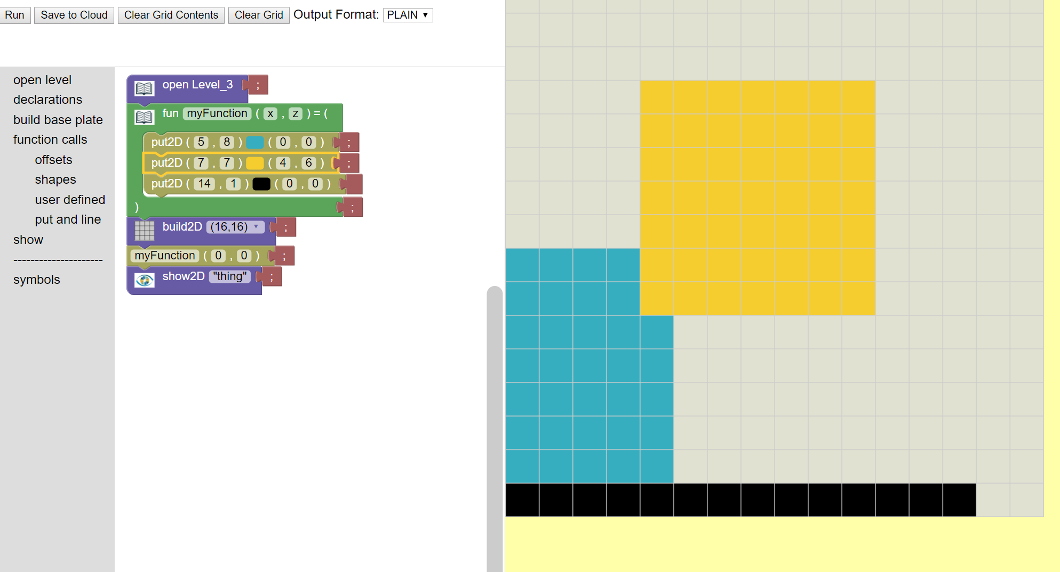
Intro to functions

Slide 8
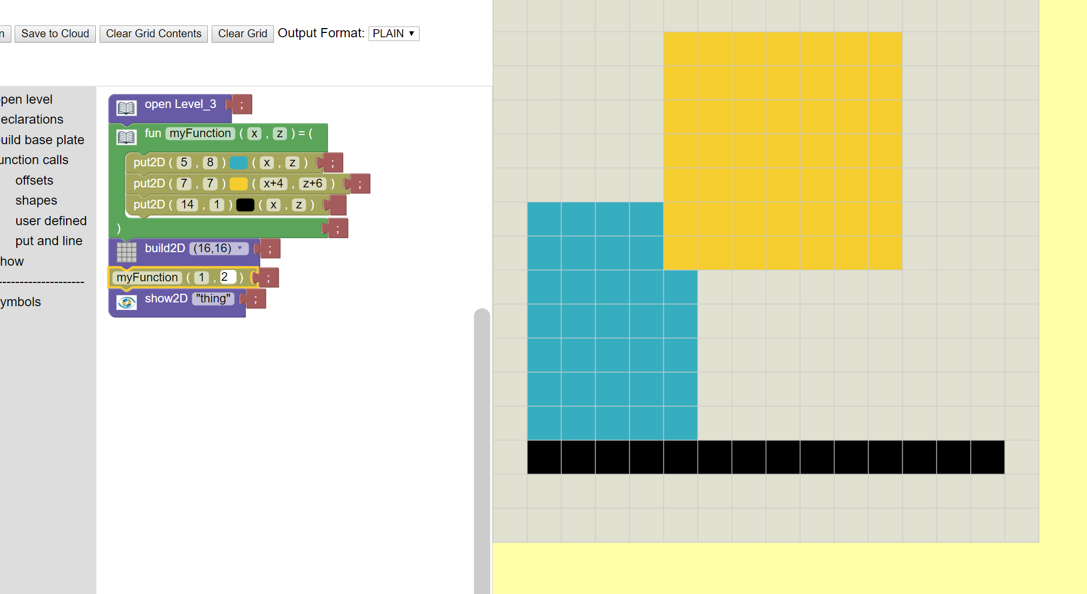
Moving pattern with parameters

Slide 9
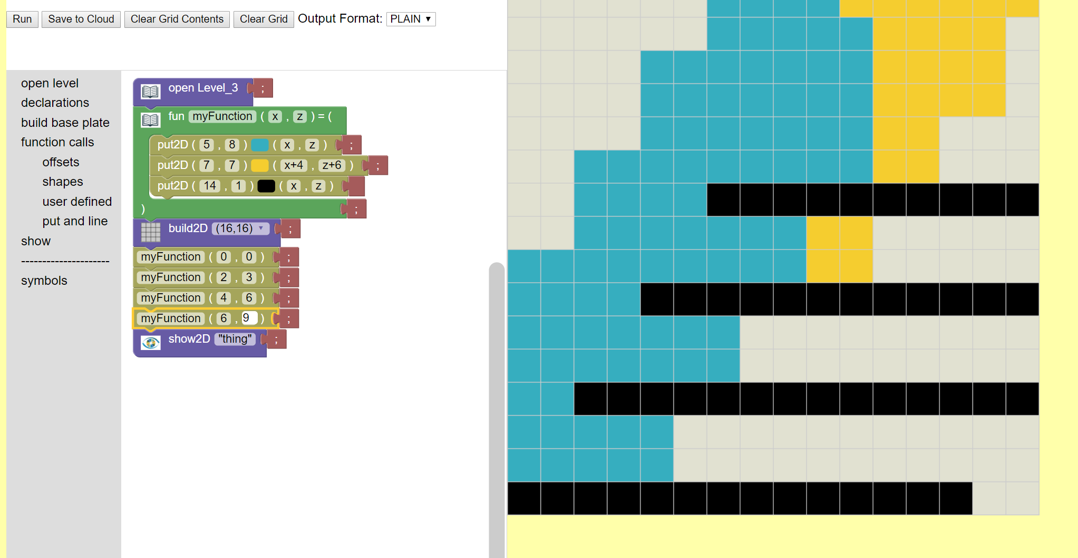
Repeating a pattern

Slide 10
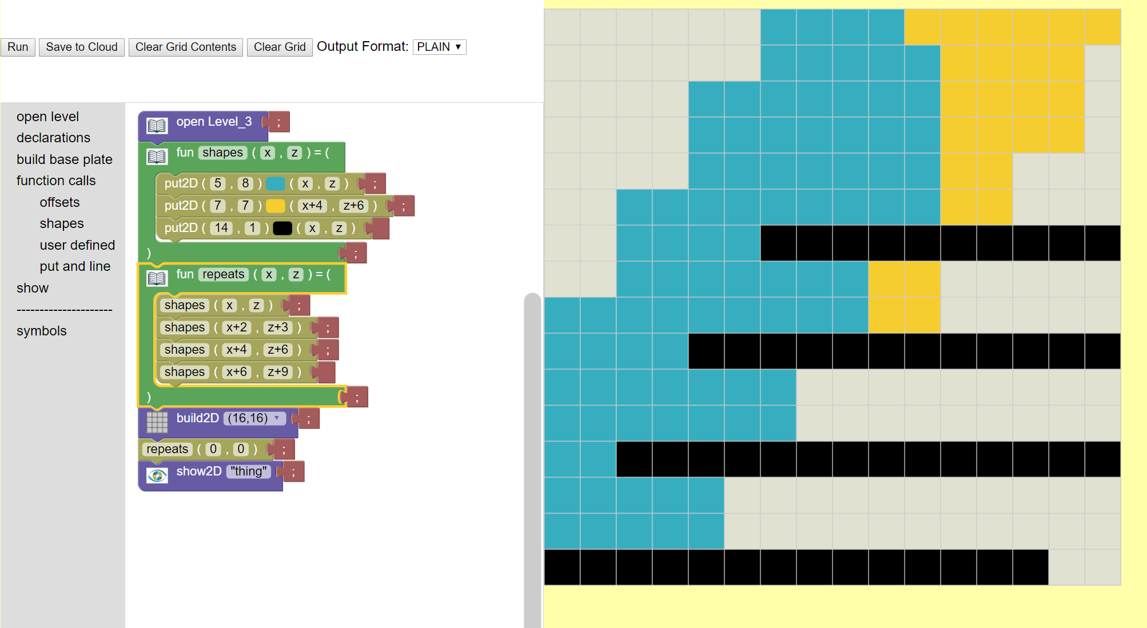
Functions inside of functions

Slide 11
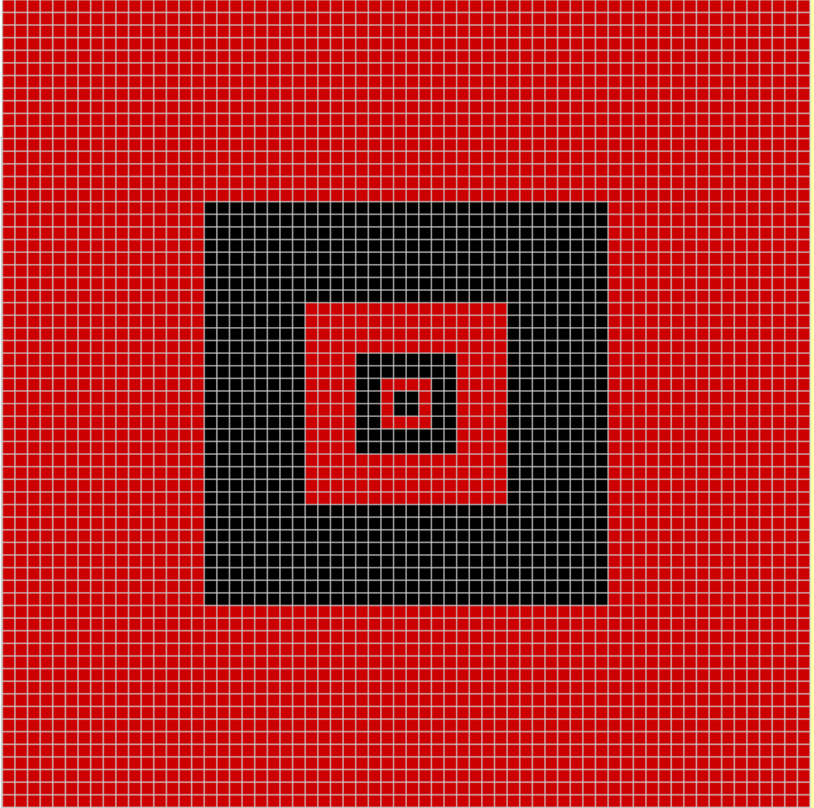
Create this object in Level 3 Brickalyer-Lite Using parameters instead of specific numbers inside the functions

Slide 12
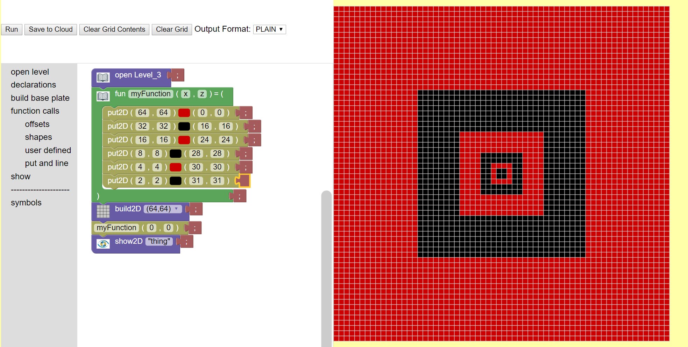
One way… what were some others?

Slide 13
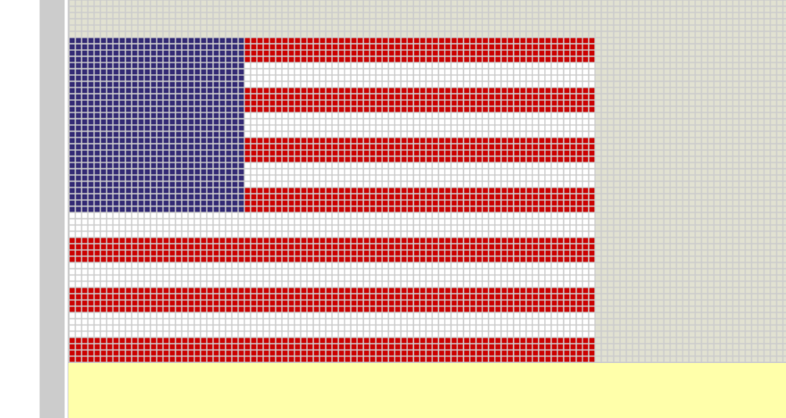
Create this flag in bricklayer-lite

Slide 14
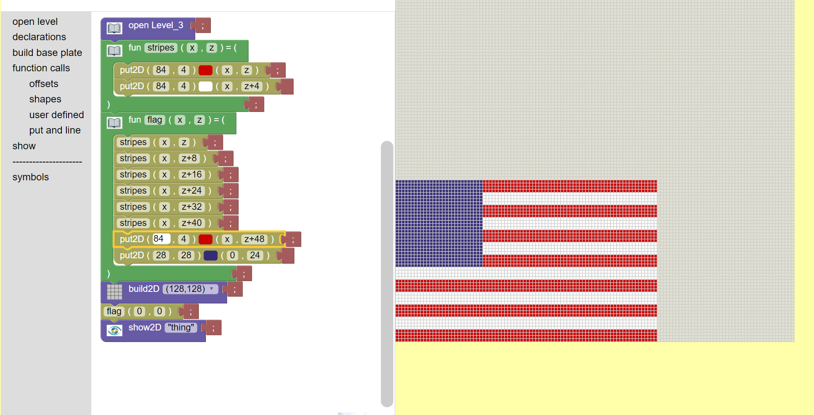
One way to make this flag…

Slide 15
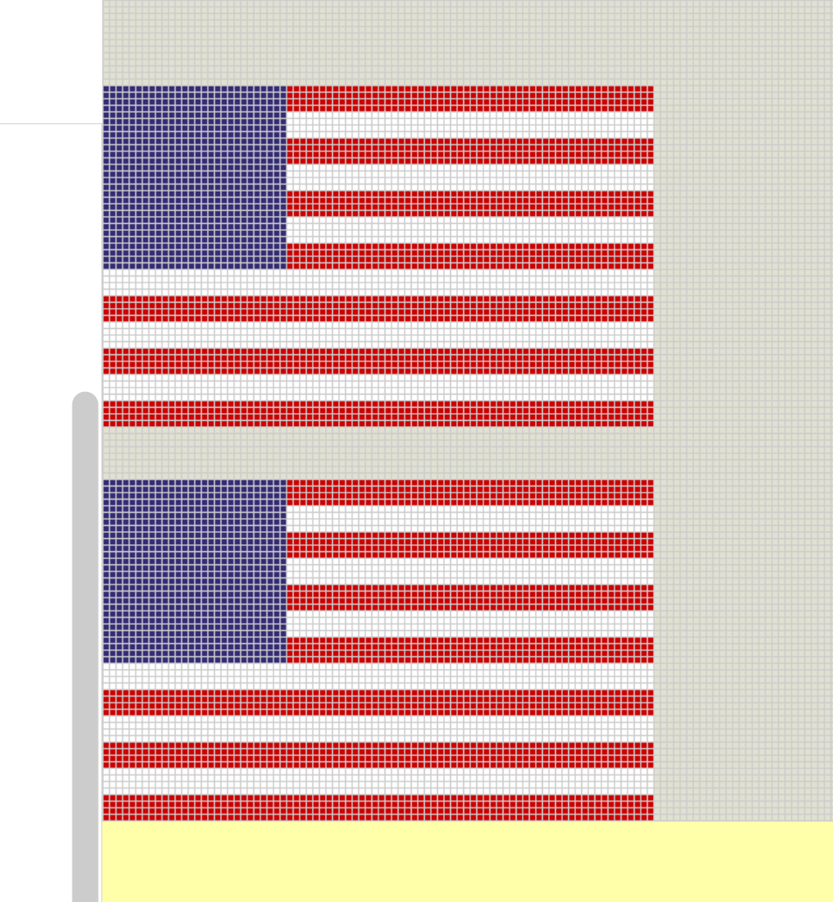
Now duplicate it…

Slide 16
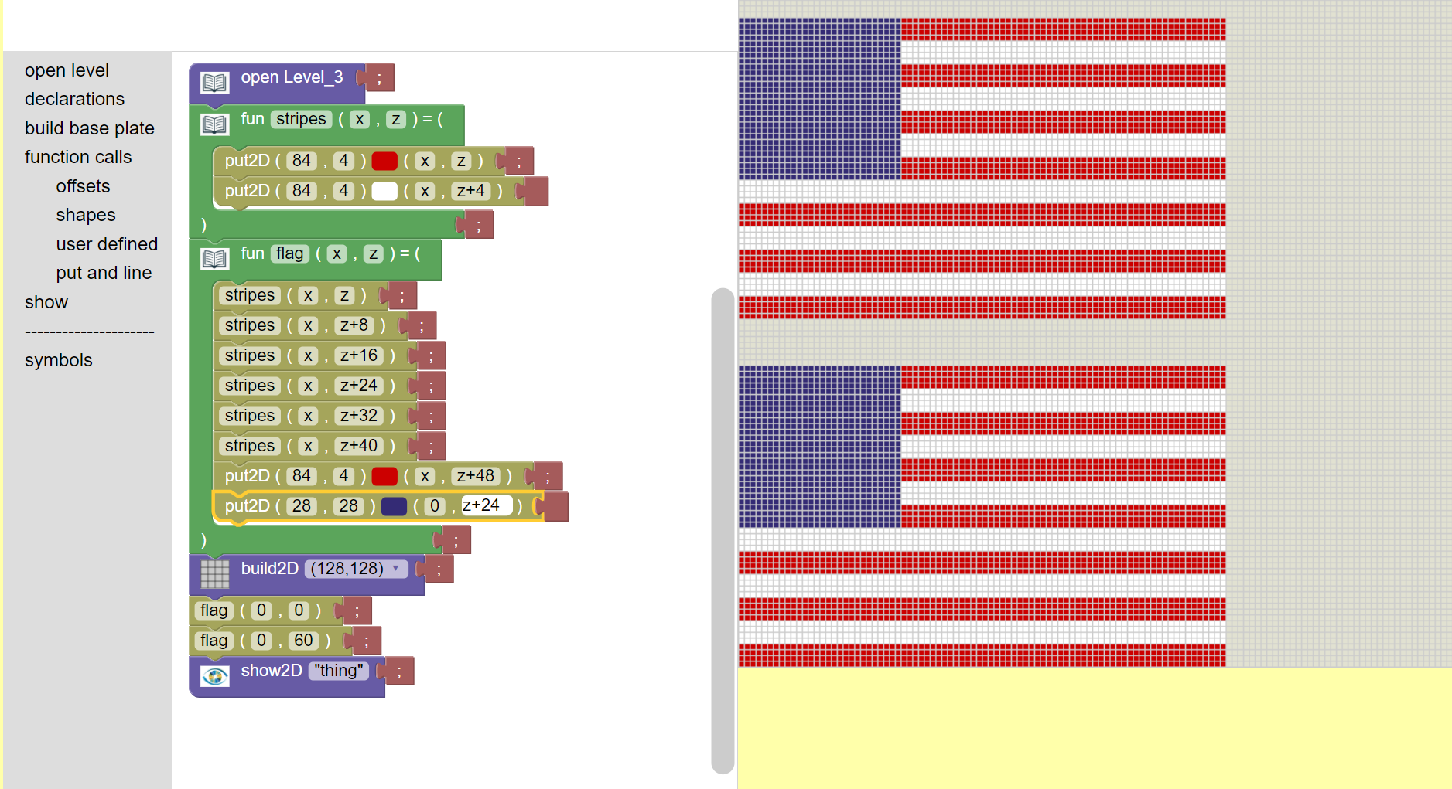
One option…

Slide 17
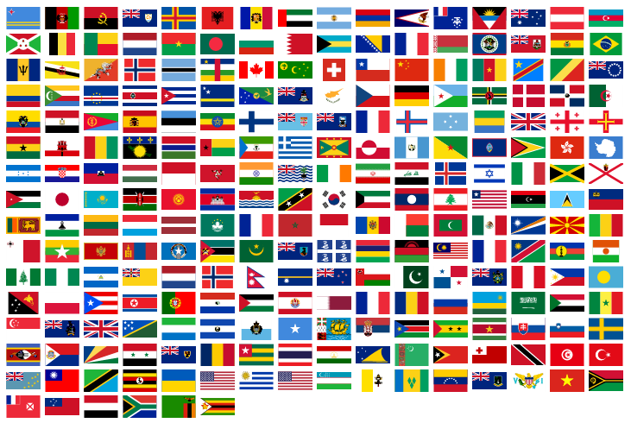
Use functions to create a countries flag…

